Slide 1
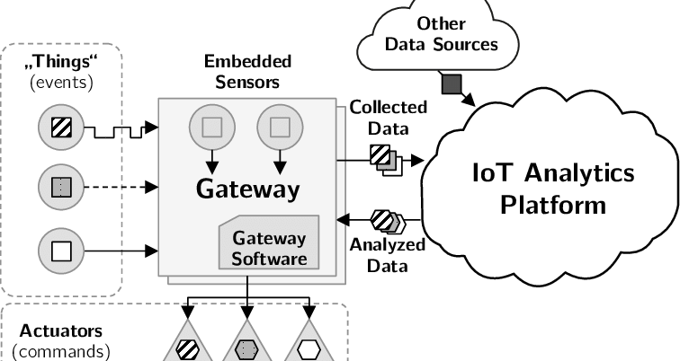
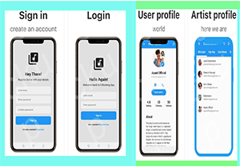
E-BOOKING -APP
Your name | Your Name| Your name
Problem
Project Design
Results
Not clearly understanding the technologies. Some of the technologies have been too difficult to implement and understand while building both the user interface and backend API. This forced us to invest more time digging deep for better understanding.
Time. The timeline for delivering has been short due. This is due to investing a lot of time in researching the requirements before jumping to the development of the project.
Project Objectives
Fraud and impersonation in booking artists(musicians) and other performers in the entertainment fraternity.
. The app solution allows us to administer and then the artists to get easily hired through the app based dashboards.
Project Requirements
Results
Include key screenshots of your system and visualisations
Result 2
Result 3
Login page
Users and artists profiles
Chat section
Call section
Financial section
notification
Conclusion
Brief summary of what you discovered based on results
Indicate and explain whether or not the data supports your hypothesis
Target Users
Future Work
User category 1
State what they will use the system for
User cateory 2
State what they will use the system for
User categor xx
State what they will use the system for
Observation 1
Observation 2
Observation 3
References
Include print and electronic sources in alphabetical order
Notes:
To change this poster, replace our sample content with your own. Or, if you'd rather start from a clean slate, press the New Slide button on the Home tab to insert a new page. Now enter your text and pictures in the empty placeholders. If you need more placeholders for titles, subtitles or body text, copy any of the existing placeholders, then drag the new one into place.

